Slide 1
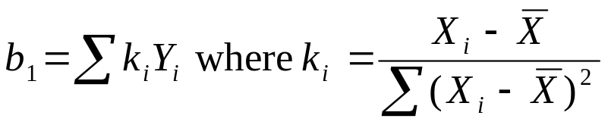
Estimation of regression function
The Gauss-Markov theorem states that the least squares estimators b₀ and b₁ are unbiased an have minimum variance among all unbiased linear estimators.
Thus E{b₀}= β₀ and E{b₁}= β₁
It can be shown that b₀ and b₁ are linear estimators. We can write that
Since the X’s are known constants, so are the K’s and b₁ is a linear combination of the Y’s.

Slide 2
Estimation of regression function
It can also be shown that b₀ is a linear combination of the Y’s.
The Gauss-Markov theorem states that among all linear estimators that are unbiased, the least squares estimates b₀ and b₁ have the smallest variability.
Thus they are more precise estimators (their sampling distributions are less variable) than any other estimators in this class.

Slide 3
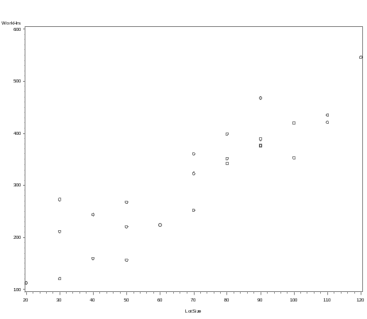
Estimation of regression function
Example. We are interested in the relationship between the size of a lot and labor hours to produce the lot.
A scatter plot of the data shows that the relationship between lot size and work hours is reasonably linear.
The scatter plot also indicates that no observations appear to be outliers from this relationship.

Slide 4
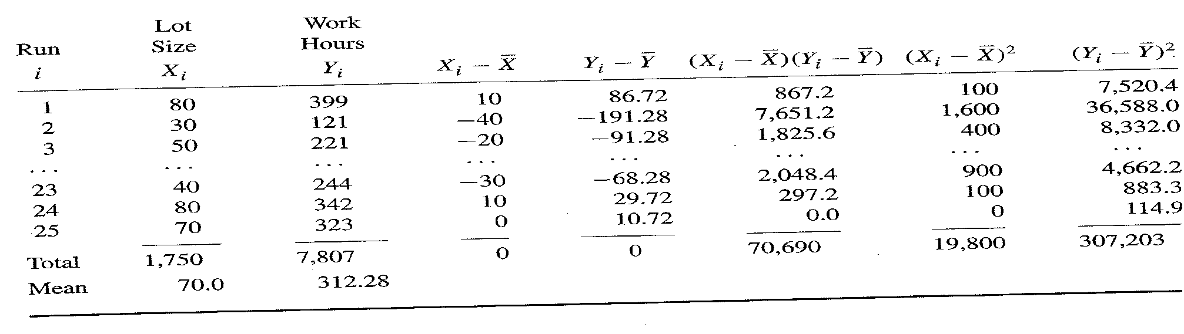
Estimation of regression function
A portion of the data. Lot sizes are multiples of 10 due to regulations.
From the table, calculate the least squares estimates b₀ and b₁.

Slide 5




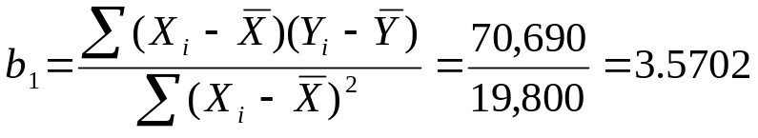
Estimation of regression function
From the table we have that

Slide 6
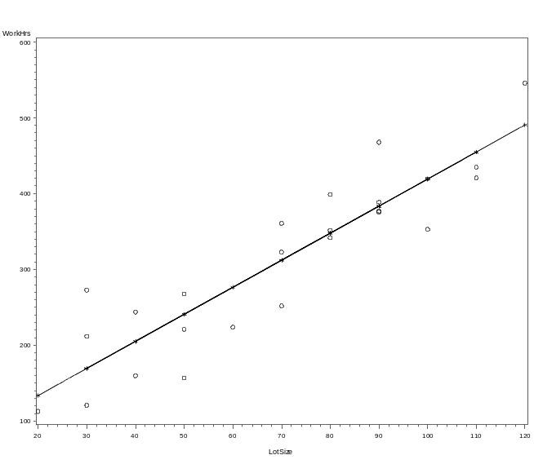
Estimation of regression function
Therefore, we estimate that the mean number of work hours increases by b₁ = 3.57 hours for each additional unit of lot size.
This estimate applies to the range of lot sizes in the data, from about 20 to 120. SAS1

Slide 7
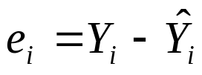

Estimation of regression function
The deviations in the data we saw before are called residuals. The i^{th} residual is the difference between the observed value Y_{i} and the corresponding fitted value Y_{i}(hat).
The residual is denoted by e_{i} and we have in general that
For our simple linear regression model, we have that

Slide 8
Estimation of regression function
Note the difference between ε_{i} and e_{i}.
ε_{i} is the model error term and represents the deviation of Y_{i} from the true unknown E{Y_{i}}, the true regression line.
e_{i} is the residual and is the deviation of Y_{i} from the estimated value of E{Y_{i}}, Y_{i}(hat).
Hence, ε_{i} is unknown and e_{i} is known. We use the e_{i} to estimate the ε_{i}.

Slide 9
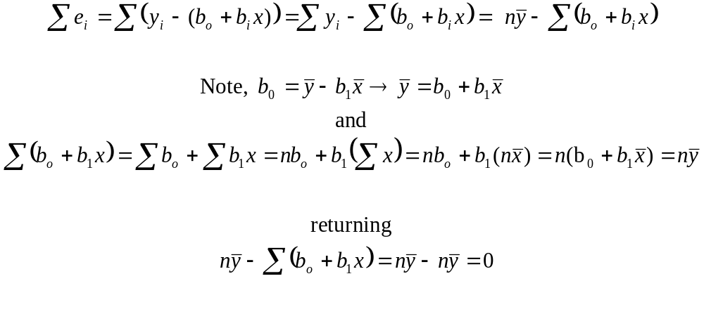
Estimation of regression function
For simple linear regression
The sum of the residuals is 0. Proof:

Slide 10

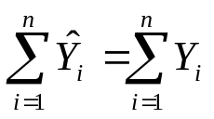
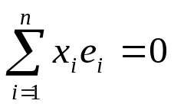
Estimation of regression function
The sum of the squared residuals, , is a minimum. This was the requirement used to solve for the least squares estimators.
The sum of the observed values Y_{i} equals the sum of the fitted values Y_{i}(hat).
The sum of the residuals weighted by their corresponding predictor variable is 0.

Slide 11
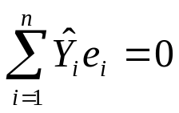
Estimation of regression function
5) The sum of the residuals weighted by their corresponding fitted value is 0.
6) The regression line always goes through the point (X(bar), Y(bar))

Slide 12
Estimation of σ²
The variance σ² of the error terms ε_{i} needs to be estimated to obtain an indication of the variability of the probability distributions of Y.
In addition, many inferences that we will do require an estimate of σ².
Consider just one population. Then σ² is estimated by the sample variance s².
To obtain s², we consider the deviation of an observation Y_{i} from it’s estimated mean, square these deviations, and then sum the squared deviations. Note, for any Y_{i} the estimated mean is Y(bar), the sample mean.

Slide 13
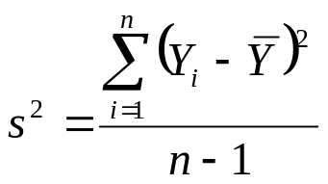
Estimation of σ²
This sum of squared deviations is called the sum of squares.
The sum of squares is then divided by the degrees of freedom associated with it.
Here the degrees of freedom are n-1 since we lose a degree of freedom because we are using Y(bar) as an estimate of the true mean μ.
sum of squares
degrees of freedom

Slide 14
Estimation of σ²
The estimator s² is an unbiased estimator of σ².
This term is a sum of squares divided by its degrees of freedom which are called mean squares.
Now consider the regression case. Note that the variance of each observation Y_{i} is σ², the same as that of each error term ε_{i}.
We will again calculate the sum of squared differences but must take into account that the Y_{i} come from different probability distributions with different means that depend on the value of X.

Slide 15

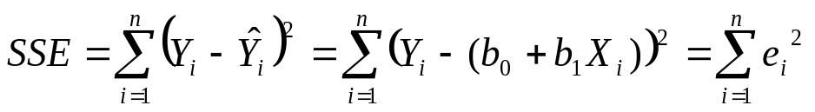
Estimation of σ²
Thus the deviation of an observation Y_{i} must be calculated around its own estimated mean Y_{i}(hat). Thus, the differences are the residuals
The appropriate sums of squares, called error sums of squares or residual sums of squares, denoted by SSE, is

Slide 16
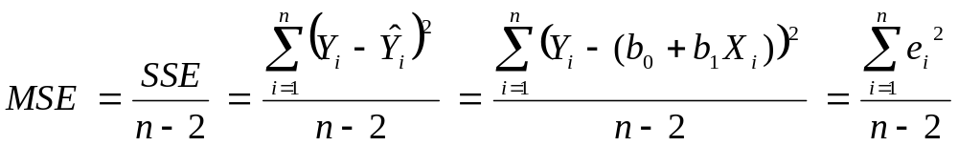
Estimation of σ²
The sum of squares SSE has n-2 degrees of freedom since we lose two degrees estimating β₀ and β₁.
The appropriate mean square called error mean square or residual mean square, denoted by MSE is
The MSE is an unbiased estimator of σ² and the square root of the MSE is an unbiased estimator of the standard deviation σ.

Slide 17
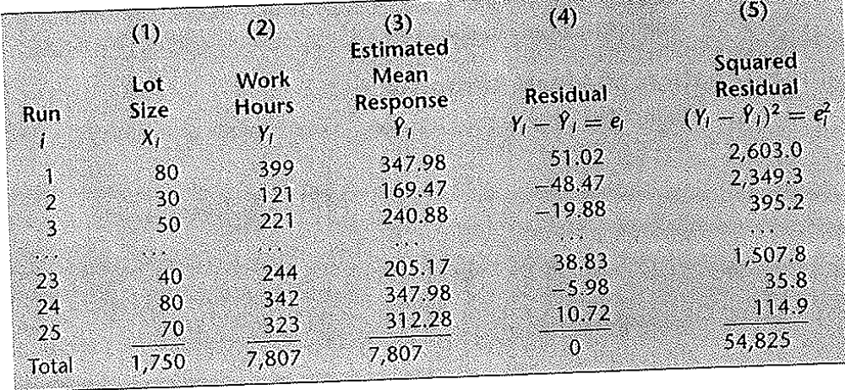
Estimation of σ²
From the table, we obtain that the sum of the squared residuals, the SSE, is 54,825.
The sample size is 25, so n-2=23 and the MSE = 54,825/23 = 2,384.
This is our point estimate of σ² and we estimate σ as the square root of 2,384 which equals 48.8. SAS: residuals_SSE

Slide 18
Normal
Error Model
No matter what distribution the error terms ε_{i} have (and hence the Y_{i}), the least squares method provides unbiased point estimates of β₀ and β₁.
These estimates have minimum variance among all unbiased linear estimators.
However, to do confidence intervals and significance tests, we need to make assumptions about the form of the distribution of the ε_{i}.
The standard assumption is that the error terms are normally distributed.

